Slide 1
Scheduler App Presentation
Mark Ekis, Austin Ross, Raymond Rennock, Mohammad Baraja, Blake Higgins

Slide 2
Goal
The goal of our group project was to create an easy to use web application where a user could enter a class schedule and a set of scheduling criteria to quickly validate whether or not the schedule had any conflicts.
The primary focus when designing the project was to make it easy to use and quick to navigate, and the secondary focus was to ensure its reliability. With its current iteration, the project is in a state where it’s easy to use and understand while still getting the job done as expected.

Slide 3
Implementation
The scheduler was implemented as a web based application. This was intended so that the user did not have to mess around with any installations to get the app working.
-Front end built with the Vue.js framework.
-The algorithm and classes were implemented in JavaScript.
-The local database was implemented with Vuex persist.

Slide 4
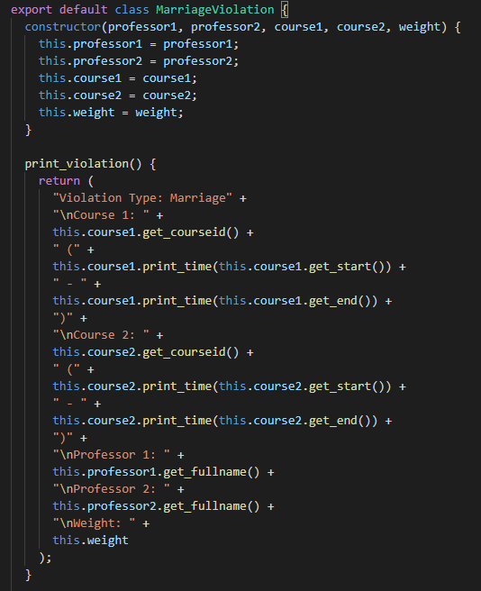
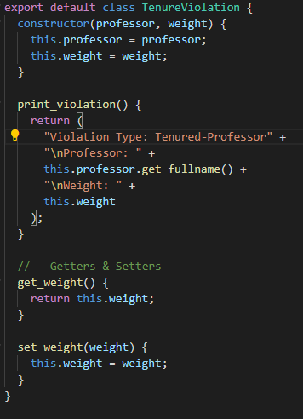
Algorithm Updates
Notes:
(Austin)
On the backend I began with adding a few more violations. In the first presentation the application was only checking for TimeRoom/TimeProfessor violations, so here you can see the implementation of Marriage and Tenure violations as well. The constraints for these are found in the schedule class which is discussed more in the next slide.

Slide 5
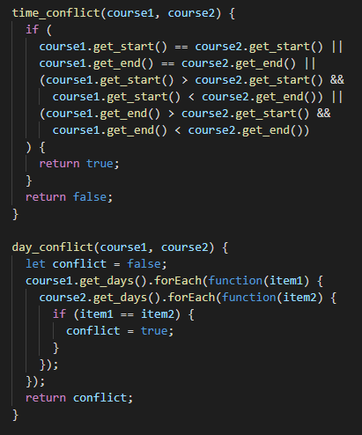
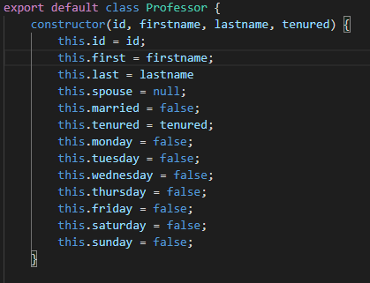
Algorithm Updates
Notes:
(Austin)
On the left here you can see a snippet of the updated code within the Schedule class. This is the primary algorithm for determining conflicts in regards to time. The algorithm first checks if two courses occur on the same day (day_conflict) and if that returns to be true, the (time_conflict) function is run to determine if there is any issue. This conflict was also updated from the previous presentation, as it originally only checked for if two courses started at the exact same time, and did not account for any overlap between the start and end times of the two courses. Also, here on the right I implemented a class for Professor, allowing us to manipulate and determine many traits about a professor such as if they are married, tenured, and which days they are currently scheduled to teach on.

Slide 6
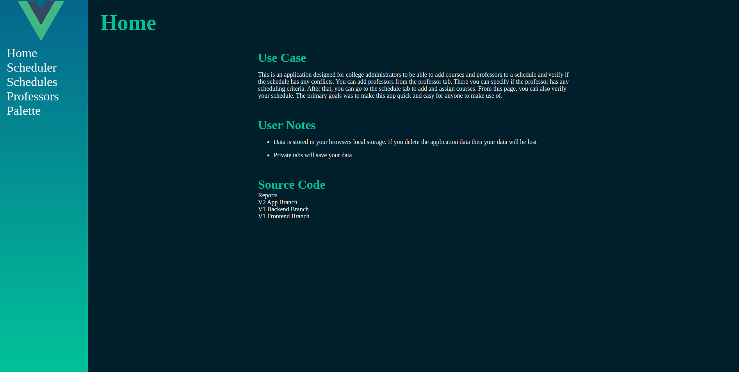
Our GUI
Notes:
(Raymond)
Importance of UI design:
Allows non saavy users to utilize your code for their use case
Often users will judge an application on looks and ease of use more than the functionality
How do we create good design?

Slide 7
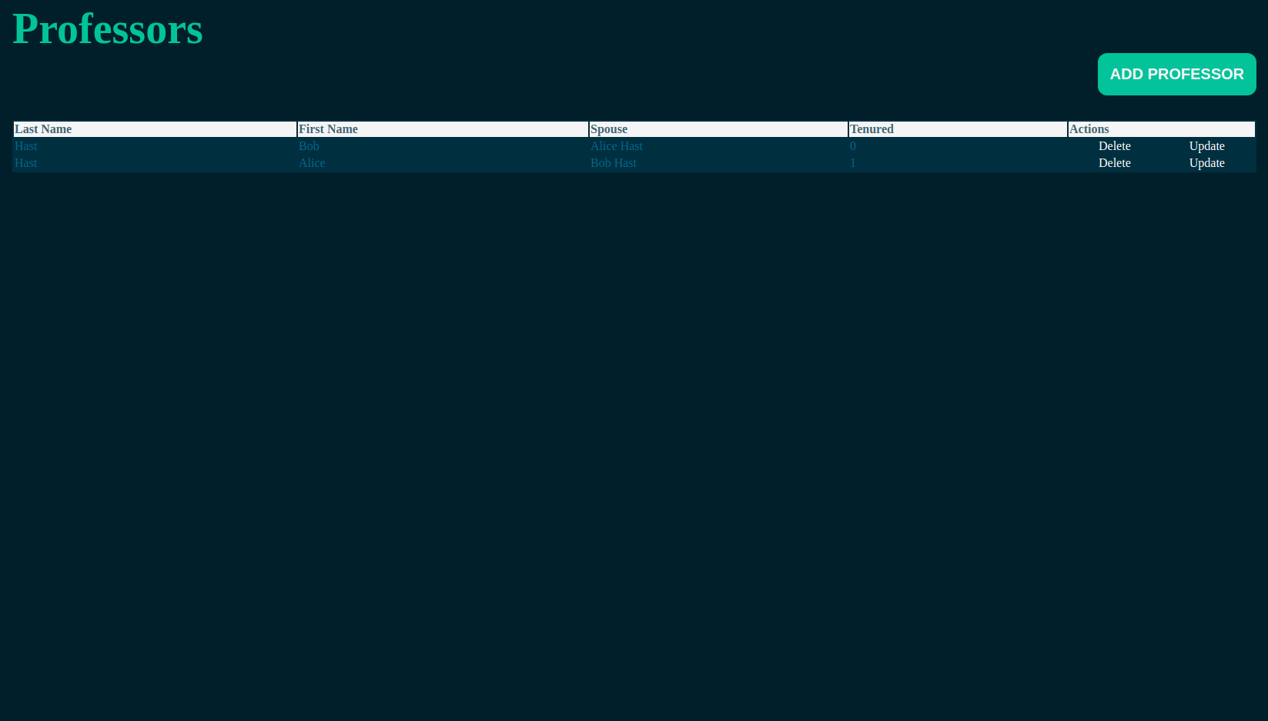
Professor | All

Slide 8
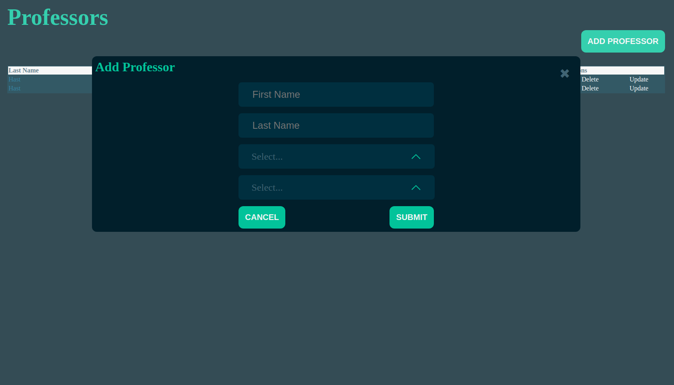
Professor | Update & Create

Slide 9
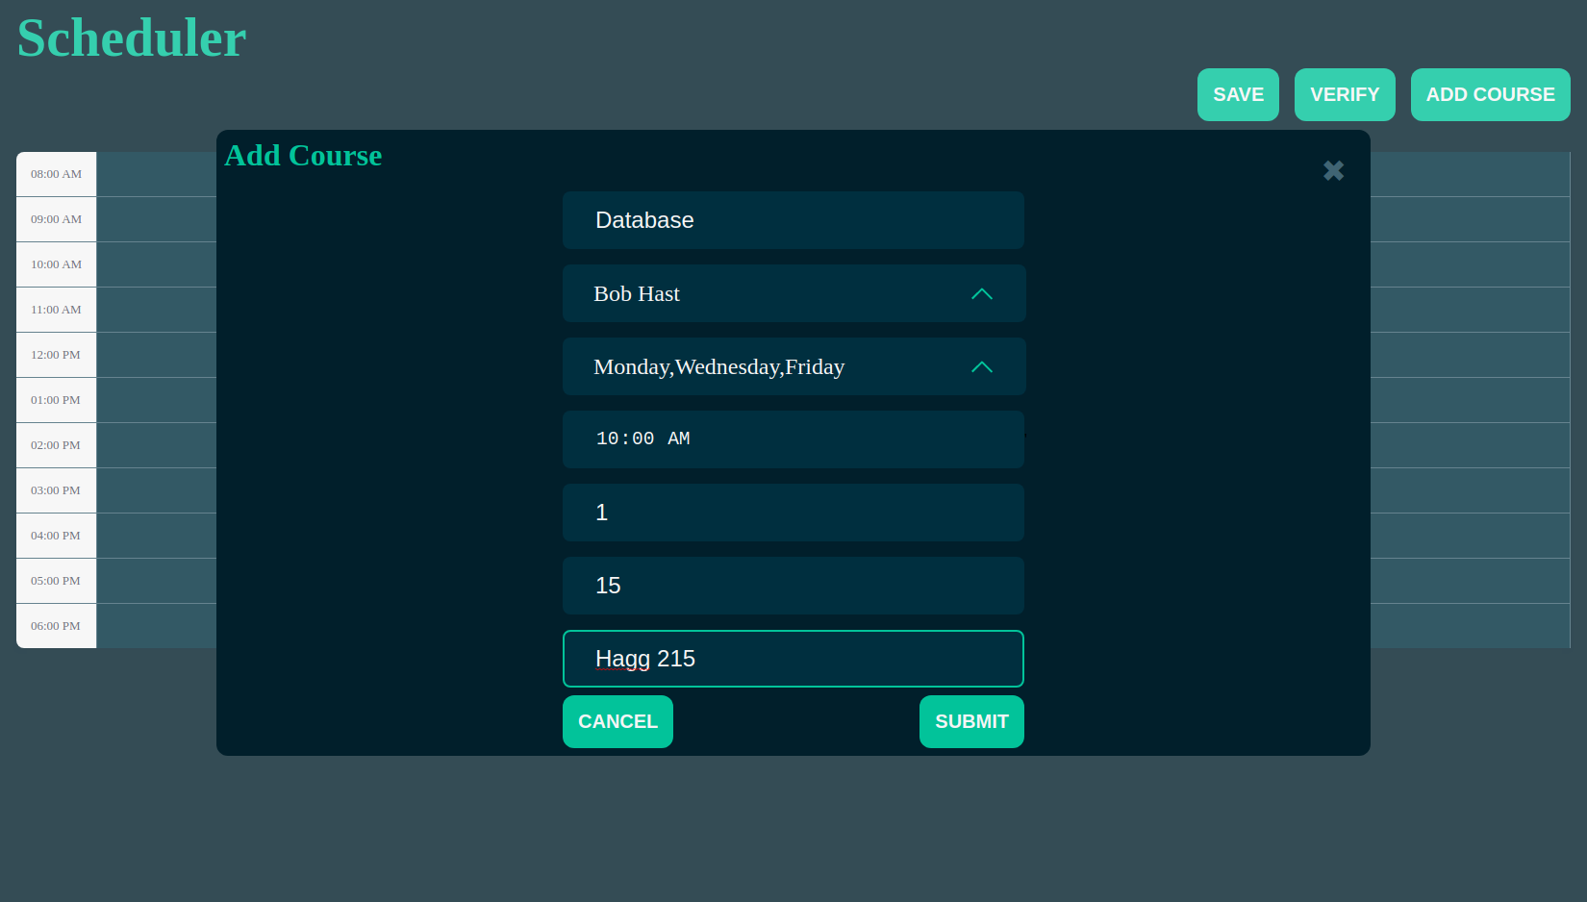
Scheduler | Create Course

Slide 10
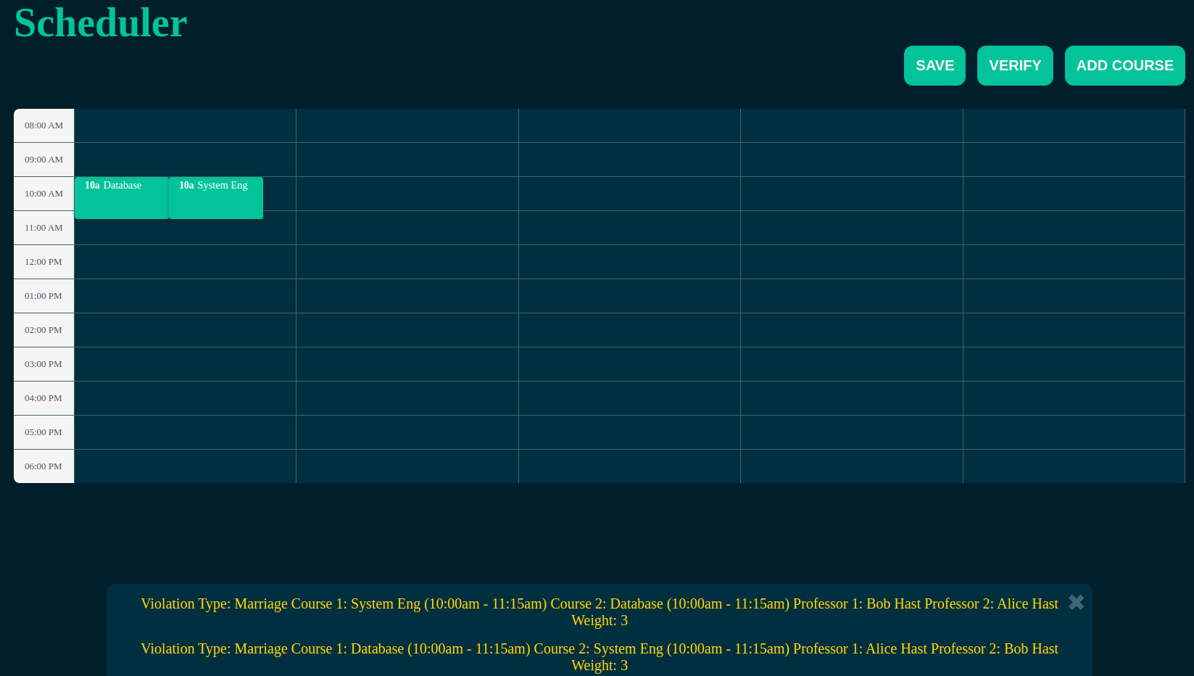
Scheduler | Verify (Marriage)

Slide 11
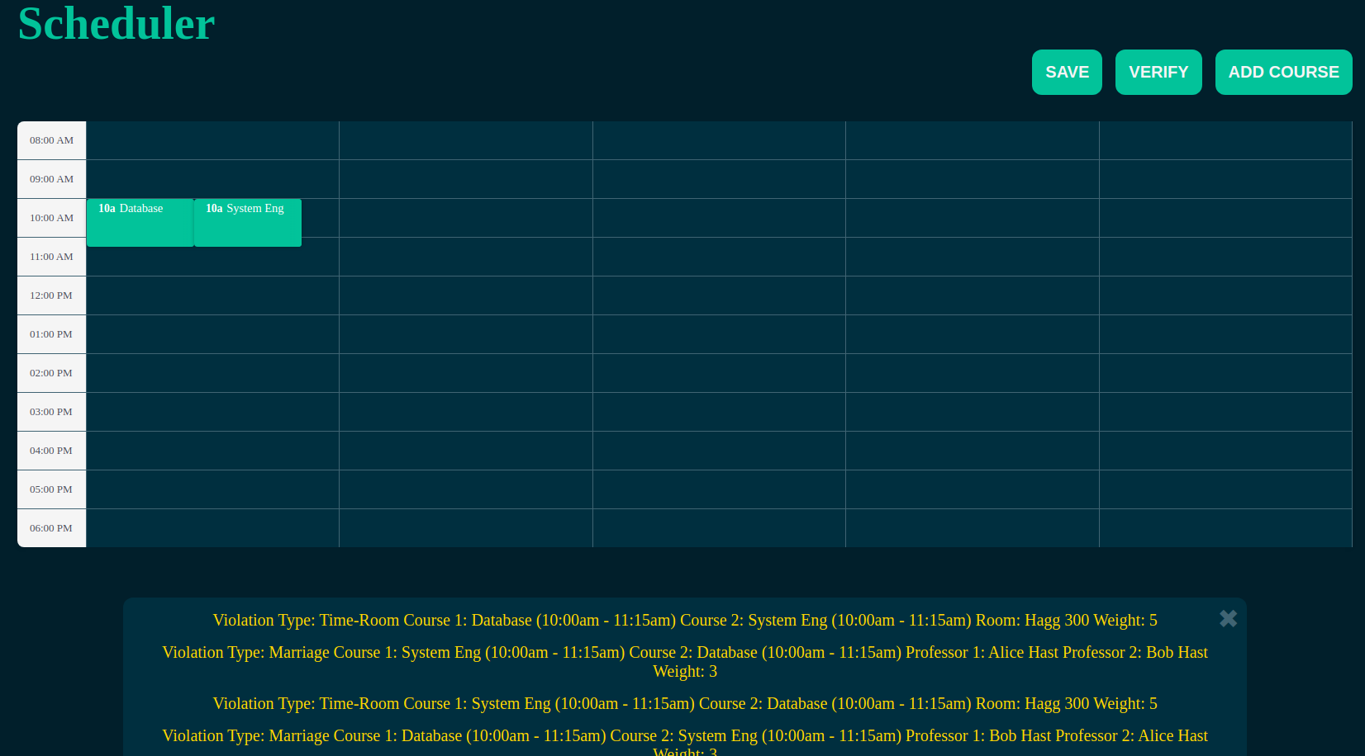
Scheduler | Verify (TimeRoom)

Slide 12
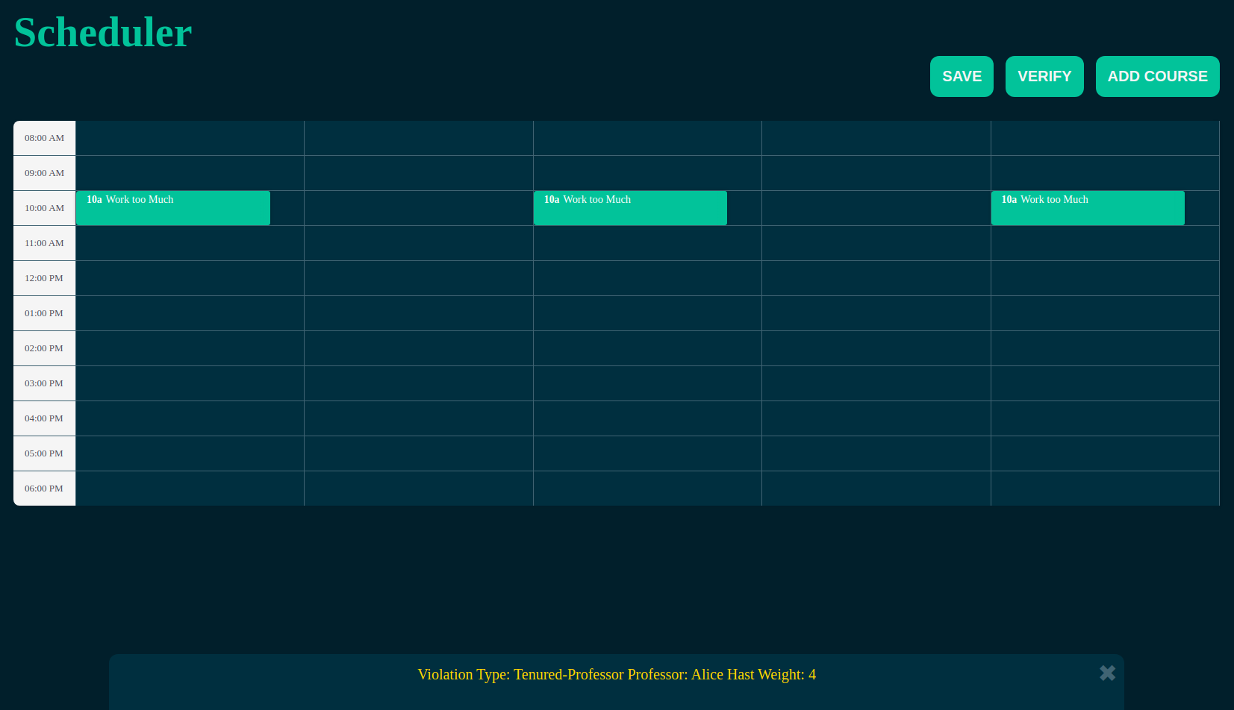
Scheduler | Verify (Tenured)

Slide 13
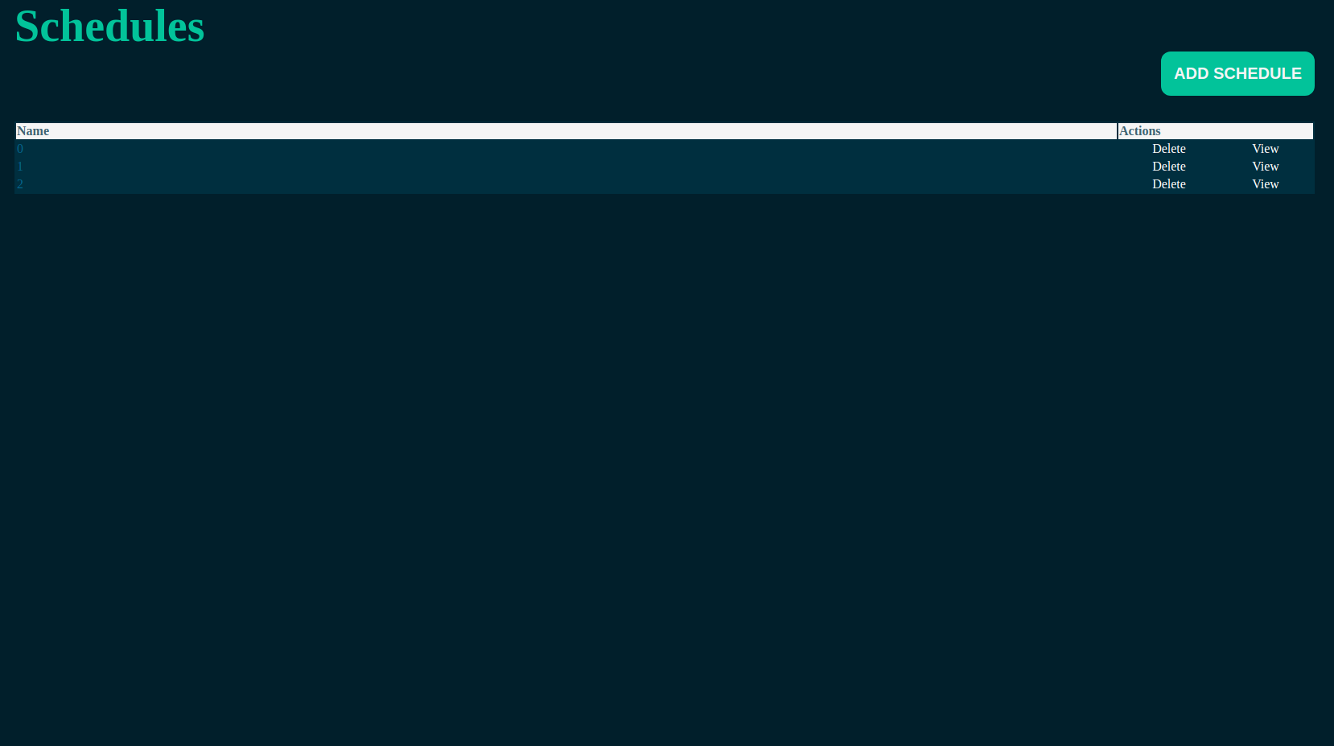
Schedules | View & Delete

Slide 14
Conclusion and Future Development
We were able to stay both on track and in communication for the duration of the project despite the unique challenges presented by the quarantine. Because of this, we were able to meet all the requirements we had starting out the project even if it was a little bit more difficult.
However, there are still potential additions that were not in our initial scope that we could also add.
The ability to generate a schedule with the given criteria (A*)
The ability to add further constraints and allow custom constraints to be created
Full login capabilities to expand functionality to a larger user base

